Slide 1
Machine Learning Project Estimate cost of house
Nadia Naji 5646456

Slide 2
First Step For All Algorithms
Load Clean Data
Feature Selection
Normalize
Plot
Algorithms
Tuning

Slide 3
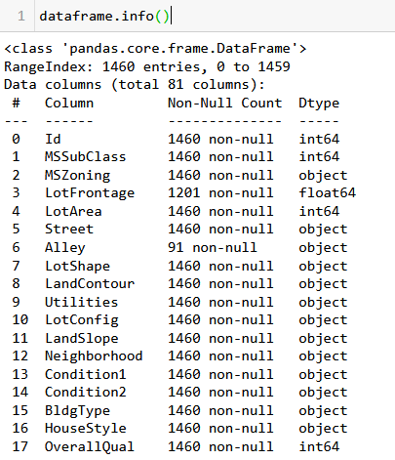
Data Set Features
(1460, 81)
MSSubClass, MSZoning, LotFrontage, LotArea, Street, Alley, LotShape, LandContour, Utilities, LotConfig, LandSlope, Neighborhood etc.
more than 80 independent parameters
Predict Sale Price
Data Set Shape (1460 , 81)

Slide 4
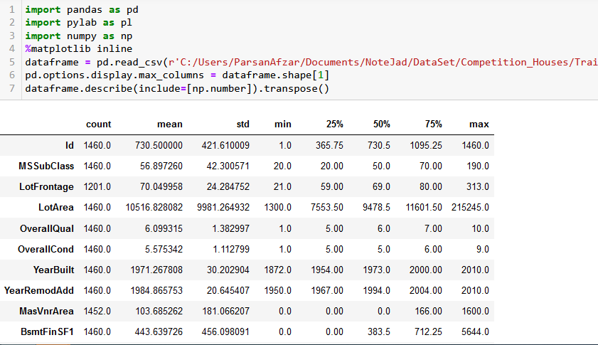
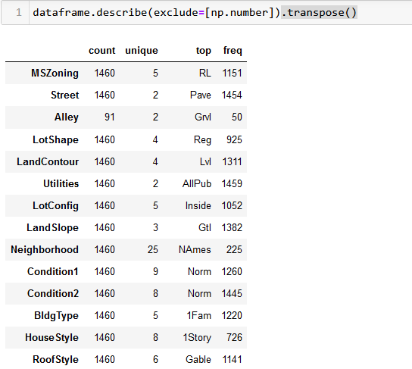
Data Set – Number VS Category

Slide 5
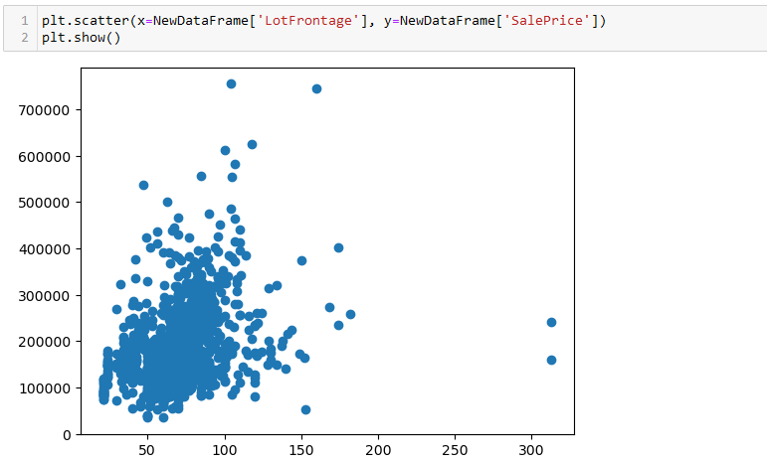
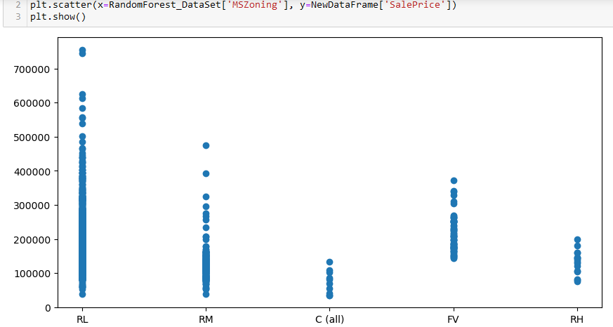
Some Plot

Slide 6
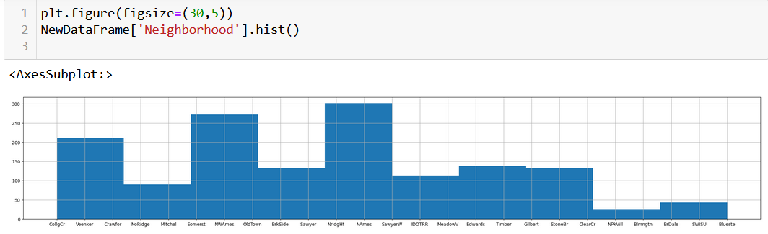
Some Plot

Slide 7
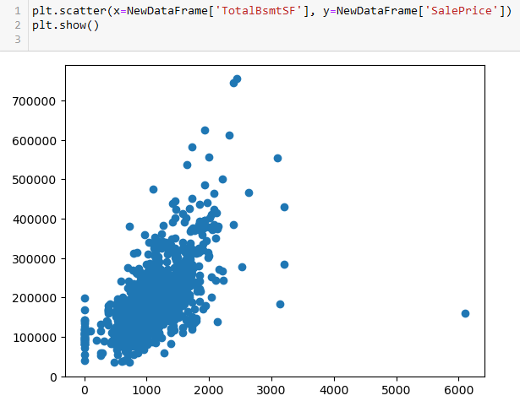
Some Plot

Slide 8
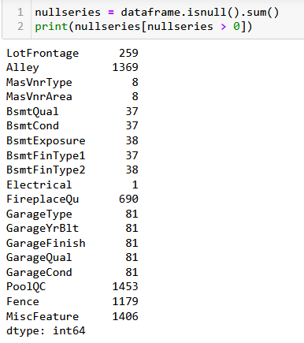
Clean Data
For more than 500 Null=>Delete
For less than 500 and number=>mean Value
For less than 500 and categorical=>Top frequent

Slide 9
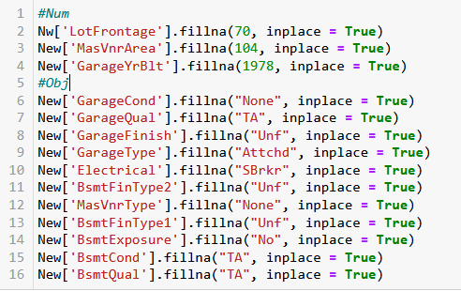
Clean Data

Slide 10
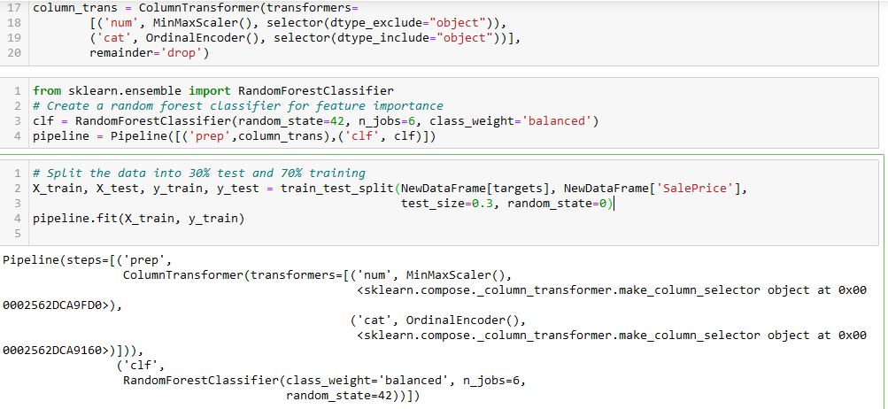
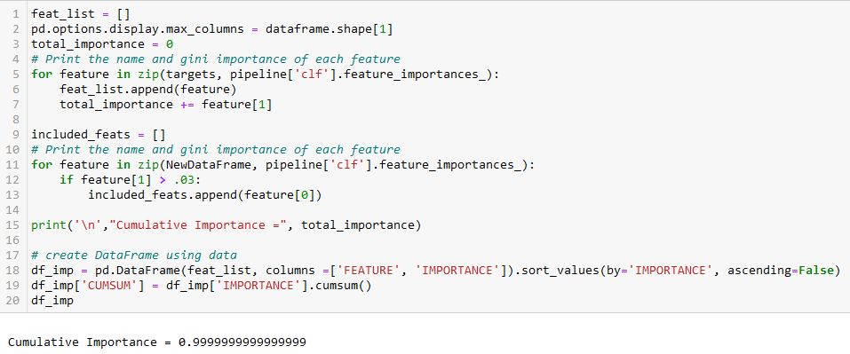
Feature Selection for Both Categorical and Numerical Feature

Slide 11
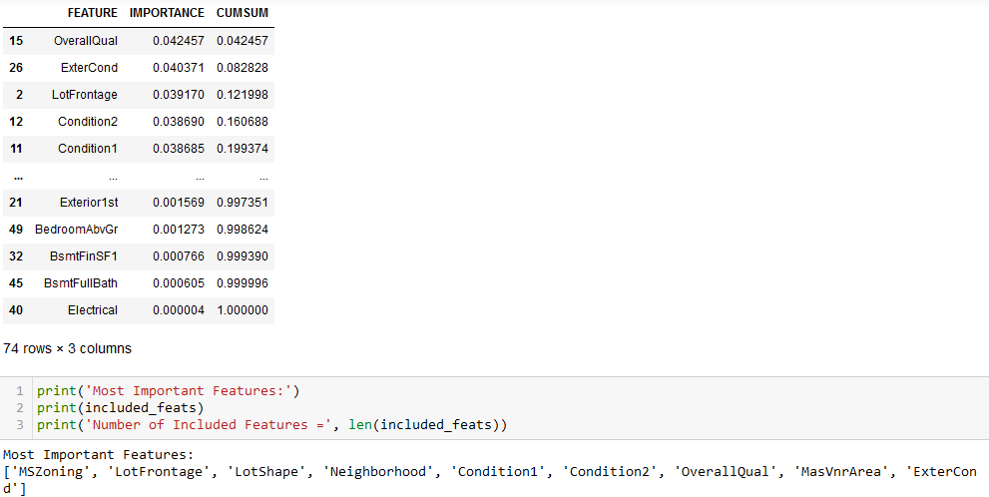
Result Of feature Importance

Slide 12
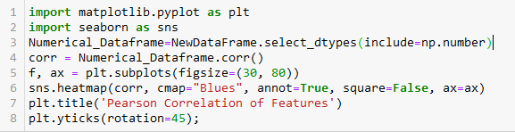
Feature Selection Numerical: Pearson's Correlation Coefficient just to show
It is too big show it from here
HeatMap

Slide 13
Types OF Algorithms suitable for data Set
Many feature with Numerical, categorical ,Boolean Type So the best Algorithm:
Random Forest Regression
Random Search CV
Grid Search CV
Gradient Boosting
Decision tree regression
Ada Boost Regressor
-it is a regression Problem SO the mean squared error (MSE) as loss function

Slide 14
Normalization
Each node in a Random Forest is not comparing feature values, it is simply splitting a sorted list that requires absolute values for branching. The algorithm is based on partitioning the data to make predictions, therefore, it does not require normalization.

Slide 15

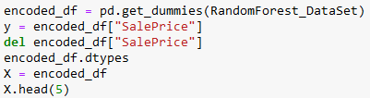
Random Forest Regression With Random Search CV Tuning

Slide 16
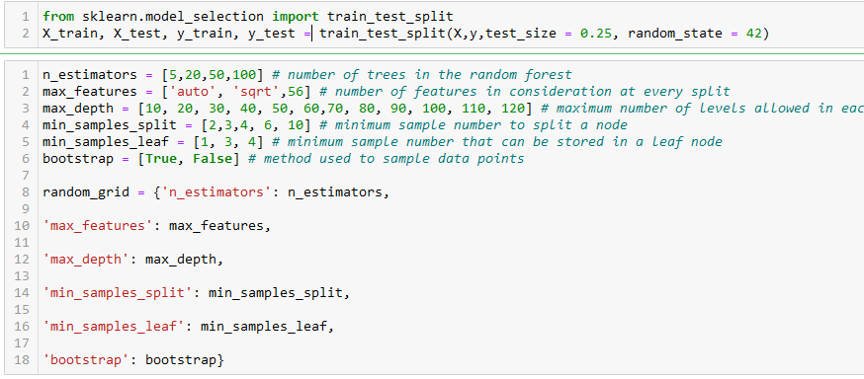
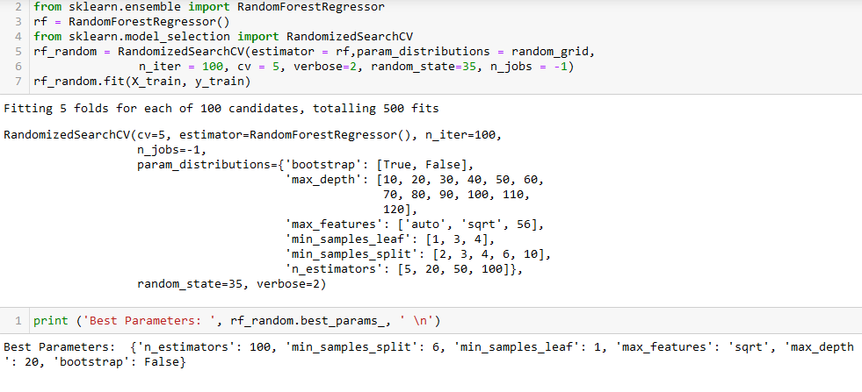
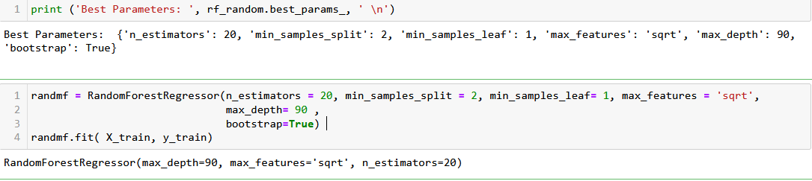
Random Forest Regression With Random Search CV Tuning

Slide 17
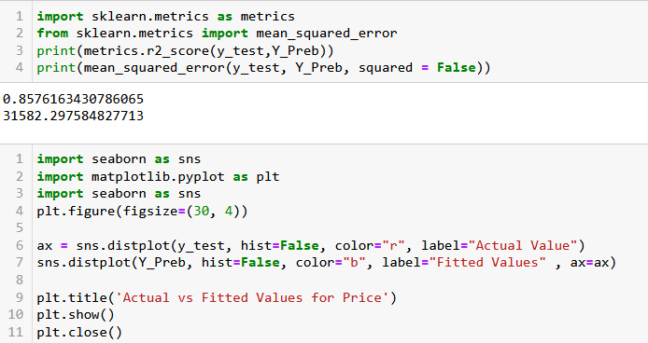
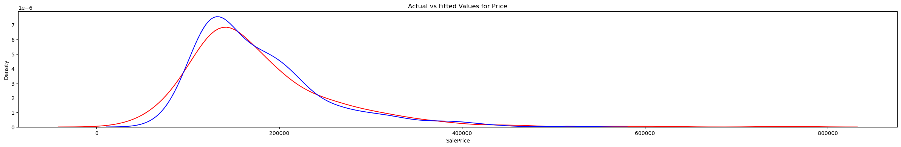
Random Forest Regression With Random Search CV Tuning

Slide 18
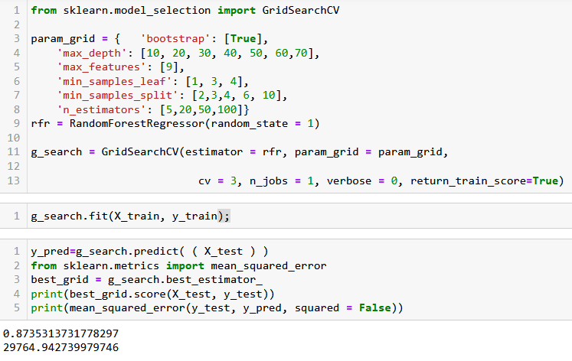
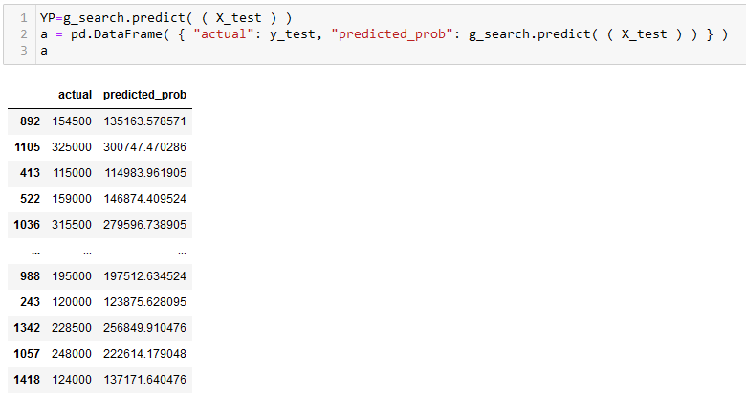
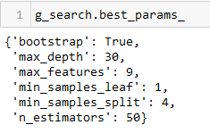
Random Forest Regression With Grid Search CV Tuning

Slide 19
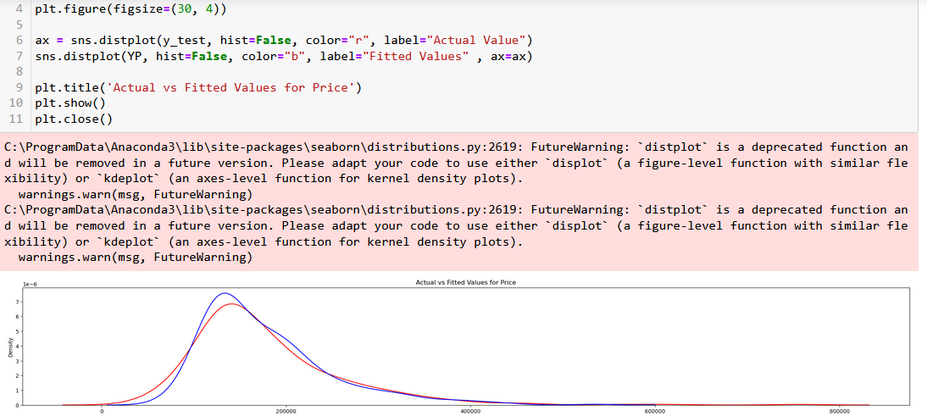
Random Forest Regression With Grid Search CV Tuning

Slide 20
Random Vs Grid Search CV
random search
Grid Search
in random search, not all the values are tested and values tested are selected at random. For example, if there are 500 values in the distribution and if we input n_iter=50 then random search will randomly sample 50 values to test.
random search only selects and tests a random combination of hyperparameters.
We can specify the number of total runs the random search should try before returning the best model.
grid search looks at every possible combination of hyperparameters to find the best model
For example, searching 20 different parameter values for each of 4 parameters will require 160,000 trials of cross-validation

Slide 21
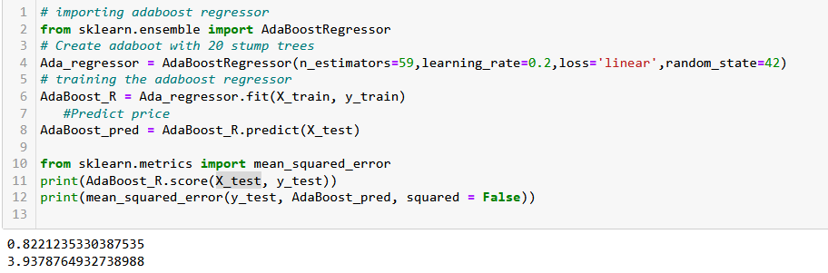
Ada Boost

Slide 22
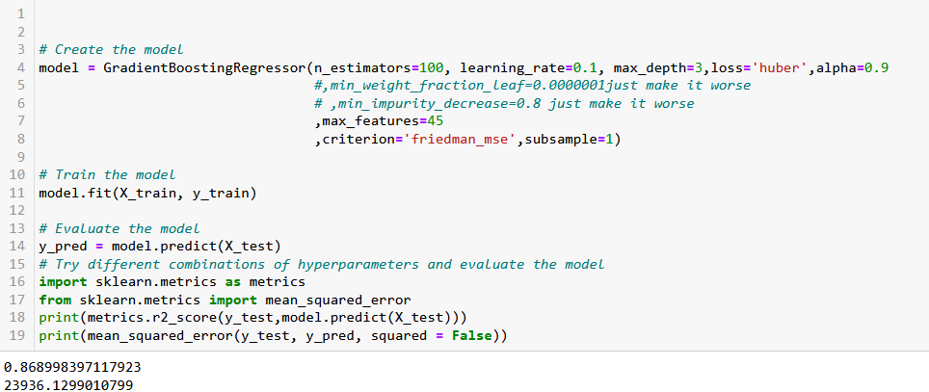
Gradient Boosting

Slide 23
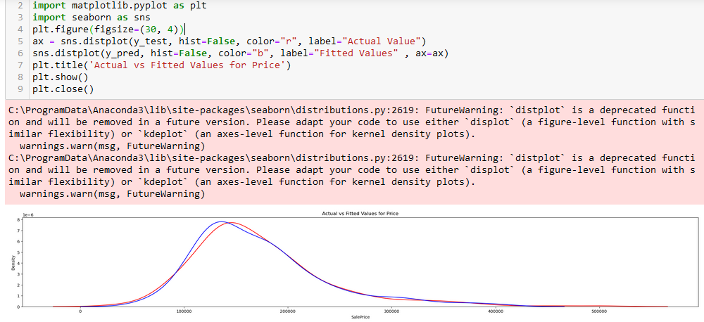
Gradient Boosting

Slide 24
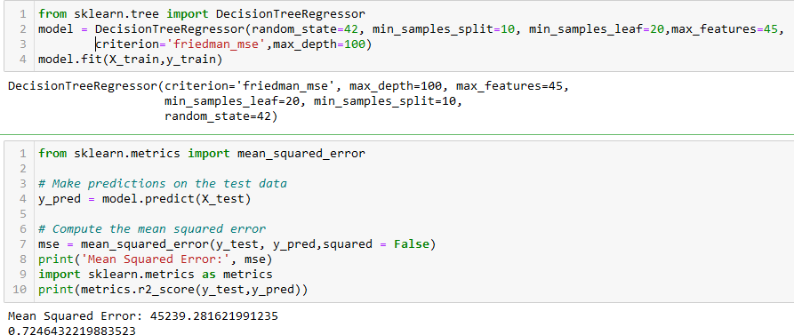
Decision tree regression

Slide 25
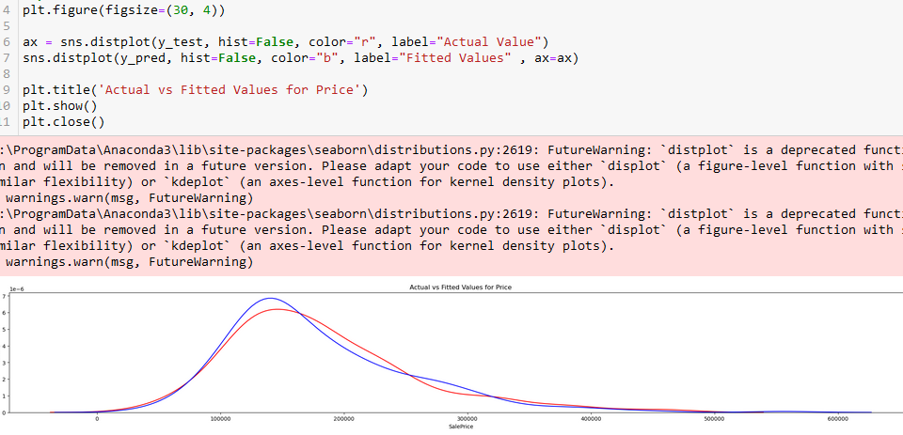
Decision tree regression

Slide 26
Final Results
Algorithm Name | Mean Squared Error | Regression Score Function
Random Forest -Random Search CV | 31582.29 | 0.8576
Random Forest -Grid Search CV | 29764.94 | 0.8735
Ada Boost Regressor | 3.93787 | 0.8221
Gradient Boosting | 23936.12 | 0.8689
Decision Tree | 45369.28 | 0.7246

Slide 27
thank you

